Slide 1
TAX Havens final presentation
Group 12:
Raluca Stanescu
Tiara Utomo
Tina Thomas
Yuxian Lun

Slide 2
Main issue
What is the impact of tax havens on non-haven countries in terms of foreign investment?
Predicted result:
Economic activity in non-havens is diverted.

Slide 3
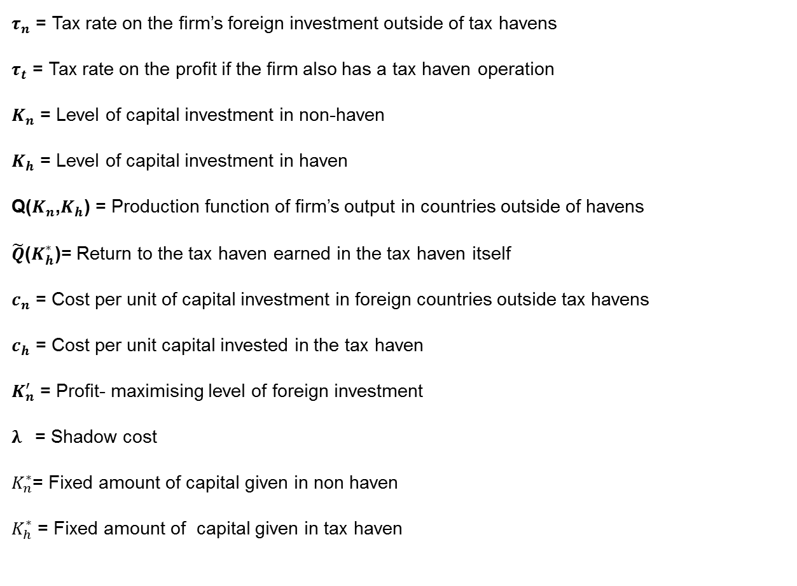
Variables
$τ_{n}$ = Tax rate on the firm’s foreign investment outside of tax havens
$τ_{t}$ = Tax rate on the profit if the firm also has a tax haven operation
$K_{n}$ = Level of capital investment in non-haven
$K_{h}$ = Level of capital investment in haven
Q($K_{n}$,$K_{h}$) = Production function of firm’s output in countries outside of havens
$\tilde{Q}$($K_{h}^{∗}$)= Return to the tax haven earned in the tax haven itself
$c_{n}$ = Cost per unit of capital investment in foreign countries outside tax havens
$c_{h}$ = Cost per unit capital invested in the tax haven
$K_{n}^{′}$ = Profit- maximising level of foreign investment
$λ$ = Shadow cost
$K_{n}^{∗}$= Fixed amount of capital given in non haven
$K_{h}^{∗}$ = Fixed amount of capital given in tax haven

Slide 4
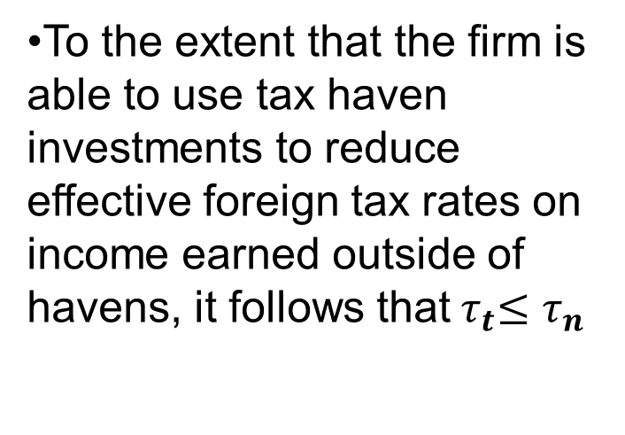
Assumptions
$τ_{n}$ = Tax rate on the firm’s foreign investment outside of tax havens
$τ_{t}$ = Tax rate on the profit if the firm also has a tax haven operation
$K_{n}$ = Level of capital investment in non-haven
$K_{h}$ = Level of capital investment in haven
Q($K_{n}$,$K_{h}$) = Production function of firm’s output in countries outside of havens
$\tilde{Q}$($K_{h}^{∗}$)= Return to the tax haven earned in the tax haven itself
$c_{n}$ = Cost per unit of capital investment in foreign countries outside tax havens
$c_{h}$ = Cost per unit capital invested in the tax haven
$K_{n}^{′}$ = Profit- maximising level of foreign investment
$λ$ = Shadow cost
$K_{n}^{∗}$= Fixed amount of capital given in non haven
$K_{h}^{∗}$ = Fixed amount of capital given in tax haven
•To the extent that the firm is able to use tax haven investments to reduce effective foreign tax rates on income earned outside of havens, it follows that${ τ}_{t}≤τ_{n}$
• Firms are assumed to invest equity capital for which there is a shadow cost$λ$.

Slide 5
Equations in the model
$τ_{n}$ = Tax rate on the firm’s foreign investment outside of tax havens
$τ_{t}$ = Tax rate on the profit if the firm also has a tax haven operation
$K_{n}$ = Level of capital investment in non-haven
$K_{h}$ = Level of capital investment in haven
Q($K_{n}$,$K_{h}$) = Production function of firm’s output in countries outside of havens
$\tilde{Q}$($K_{h}^{∗}$)= Return to the tax haven earned in the tax haven itself
$c_{n}$ = Cost per unit of capital investment in foreign countries outside tax havens
$c_{h}$ = Cost per unit capital invested in the tax haven
$K_{n}^{′}$ = Profit- maximising level of foreign investment
$λ$ = Shadow cost
$K_{n}^{∗}$= Fixed amount of capital given in non haven
$K_{h}^{∗}$ = Fixed amount of capital given in tax haven
If the firm elects not to invest in the tax haven, its after-tax returns are given by:
$π_{1}≡\left(1−τ_{n}\right)Q\left(K_{n}^{′},0\right)−λc_{n}K_{n}^{′}$.(1)
in which $K_{n}^{′}$= the profit-maximizing level of foreign investment, characterized by the first-order condition:
$\left(1−τ_{n}\right)\frac{∂Q\left(K_{n}^{′},0\right)}{∂K_{n}}= λc_{n} (2)$

Slide 6
Equations in the model
$τ_{n}$ = Tax rate on the firm’s foreign investment outside of tax havens
$τ_{t}$ = Tax rate on the profit if the firm also has a tax haven operation
$K_{n}$ = Level of capital investment in non-haven
$K_{h}$ = Level of capital investment in haven
Q($K_{n}$,$K_{h}$) = Production function of firm’s output in countries outside of havens
$\tilde{Q}$($K_{h}^{∗}$)= Return to the tax haven earned in the tax haven itself
$c_{n}$ = Cost per unit of capital investment in foreign countries outside tax havens
$c_{h}$ = Cost per unit capital invested in the tax haven
$K_{n}^{′}$ = Profit- maximising level of foreign investment
$λ$ = Shadow cost
$K_{n}^{∗}$= Fixed amount of capital given in non haven
$K_{h}^{∗}$ = Fixed amount of capital given in tax haven
If the firm instead chooses to invest in the tax haven, its returns are given by:
$π_{t}≡\left(1−τ_{t}\right)Q\left(K_{n}^{∗},K_{h}^{∗}\right)+\tilde{Q}\left(K_{h}^{∗}\right)−λ(c_{n}K_{n}^{∗}+c_{h}K_{h}^{∗})$ (3)
in which $K_{n}^{∗}$ satisfies:
$$\left(1−τ_{t}\right)\frac{∂Q\left(K_{n}^{∗},K_{h}^{∗}\right)}{∂K_{n}}= λc_{n} (4)$$
Notes:
gggggggg

Slide 7
Equations in the model
$τ_{n}$ = Tax rate on the firm’s foreign investment outside of tax havens
$τ_{t}$ = Tax rate on the profit if the firm also has a tax haven operation
$K_{n}$ = Level of capital investment in non-haven
$K_{h}$ = Level of capital investment in haven
Q($K_{n}$,$K_{h}$) = Production function of firm’s output in countries outside of havens
$\tilde{Q}$($K_{h}^{∗}$)= Return to the tax haven earned in the tax haven itself
$c_{n}$ = Cost per unit of capital investment in foreign countries outside tax havens
$c_{h}$ = Cost per unit capital invested in the tax haven
$K_{n}^{′}$ = Profit- maximising level of foreign investment
$λ$ = Shadow cost
$K_{n}^{∗}$= Fixed amount of capital given in non haven
$K_{h}^{∗}$ = Fixed amount of capital given in tax haven
The first-order Conditions (2) and (4) together imply that $K_{n}^{′}$and $K_{n}^{∗}$ satisfy:
$\frac{∂Q\left(K_{n}^{∗},K_{h}^{∗}\right)}{∂K_{n}}=\frac{\left(1−τ_{n}\right)}{\left(1−τ_{h}\right)}\frac{∂Q\left(K_{n}^{′},0\right)}{∂K_{n}}$ (5)

Slide 8
Two cases
We now consider two cases to demonstrate that the relationship between $τ_{n}$ and $τ_{h}$ is theoretically ambiguous:
Case 1: firm can use tax havens to reduce foreign tax rates on income earned outside of havens ($τ_{n}≥ τ_{h}$).
Case 2: tax havens do not reduce foreign tax rates ( $τ_{n}⋍τ_{h}$).

Slide 9


1st case
$τ_{1}$ = Tax rate on the firm’s foreign investment outside of tax havens
$τ_{2}$ = Tax rate on the profit if the firm also has a tax haven operation
$K_{1}$ = Level of capital investment in non-haven
$K_{2}$ = Level of capital investment in haven
Q($K_{1}$,$K_{2}$) = Production function of firm’s output in countries outside of havens
$\tilde{Q}$($K_{2}^{∗}$) = Return to the tax haven earned in the tax haven itself
$c_{1}$ = Cost per unit of capital investment in foreign countries outside tax havens
$c_{2}$ = Cost per unit capital invested in the tax haven
$K_{1}^{′}$ = Profit- maximising level of foreign investment
$λ$= Shadow cost
$K_{1}^{∗}$ = Fixed amount of capital given in non haven
$K_{2}^{∗}$ = Fixed amount of capital given in tax haven
Assumption:
$\frac{∂Q\left(K_{n},K_{h}^{∗}\right)}{∂K_{n}}=\frac{∂Q\left(K_{n},0\right)}{∂K_{n}}$
Because ${ τ}_{t}≤τ_{n}$
$\left(1−τ_{n}\right)≤ \left(1−τ_{t}\right)$
$0<\frac{\left(1−τ_{n}\right)}{\left(1−τ_{t}\right)}≤1$
=> $\frac{∂Q\left(K_{n}^{∗},K_{h}^{∗}\right)}{∂K_{n}}≤\frac{∂Q\left(K_{n}^{′},0\right)}{∂K_{n}}$ (6)

Slide 10
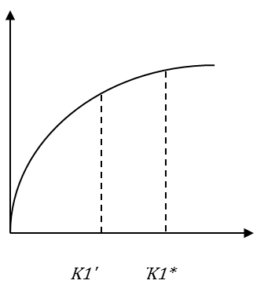
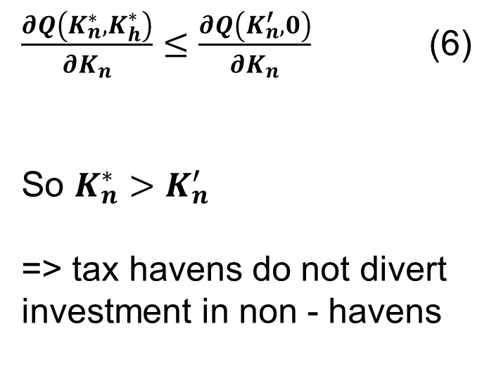
1st case
$τ_{n}$ = Tax rate on the firm’s foreign investment outside of tax havens
$τ_{t}$ = Tax rate on the profit if the firm also has a tax haven operation
$K_{n}$ = Level of capital investment in non-haven
$K_{h}$ = Level of capital investment in haven
Q($K_{n}$,$K_{h}$) = Production function of firm’s output in countries outside of havens
$\tilde{Q}$($K_{h}^{∗}$)= Return to the tax haven earned in the tax haven itself
$c_{n}$ = Cost per unit of capital investment in foreign countries outside tax havens
$c_{h}$ = Cost per unit capital invested in the tax haven
$K_{n}^{′}$ = Profit- maximising level of foreign investment
$λ$ = Shadow cost
$K_{n}^{∗}$= Fixed amount of capital given in non haven
$K_{h}^{∗}$ = Fixed amount of capital given in tax haven
The marginal product of capital investment is subject to diminishing returns => concavity.
Product of capital Investment
$\frac{∂Q\left(K_{n}^{∗},K_{h}^{∗}\right)}{∂K_{n}}≤\frac{∂Q\left(K_{n}^{′},0\right)}{∂K_{n}}$ (6)
So $K_{n}^{∗}>K_{n}^{′}$
=> tax havens do not divert investment in non - havens
$$K_{n}^{∗}$$
$$K_{n}^{′}$$
Capital investment

Slide 11
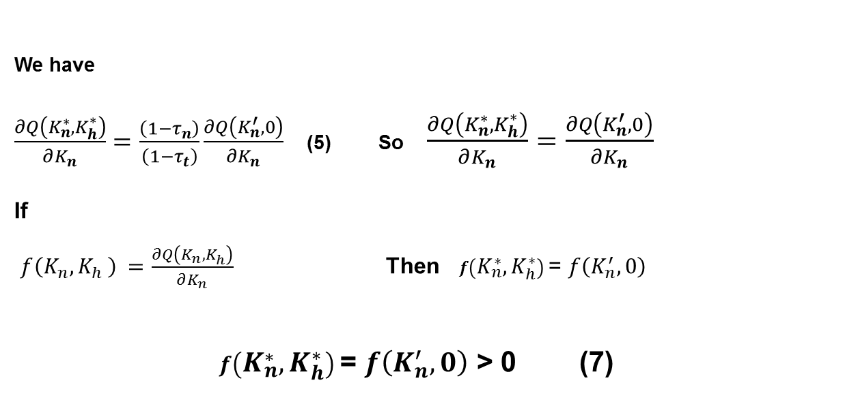
2nd case
$τ_{n}$ = Tax rate on the firm’s foreign investment outside of tax havens
$τ_{t}$ = Tax rate on the profit if the firm also has a tax haven operation
$K_{n}$ = Level of capital investment in non-haven
$K_{h}$ = Level of capital investment in haven
Q($K_{n}$,$K_{h}$) = Production function of firm’s output in countries outside of havens
$\tilde{Q}$($K_{h}^{∗}$)= Return to the tax haven earned in the tax haven itself
$c_{n}$ = Cost per unit of capital investment in foreign countries outside tax havens
$c_{h}$ = Cost per unit capital invested in the tax haven
$K_{n}^{′}$ = Profit- maximising level of foreign investment
$λ$ = Shadow cost
$K_{n}^{∗}$= Fixed amount of capital given in non haven
$K_{h}^{∗}$ = Fixed amount of capital given in tax haven
1st Assumption: Tax havens do not appreciably reduce effective foreign tax rates
$$τ_{n}≅τ_{t}$$
We have
$\frac{∂Q\left(K_{n}^{∗},K_{h}^{∗}\right)}{∂K_{n}}=\frac{\left(1−τ_{n}\right)}{\left(1−τ_{t}\right)}\frac{∂Q\left(K_{n}^{′},0\right)}{∂K_{n}}$ (5) So $\frac{∂Q\left(K_{n}^{∗},K_{h}^{∗}\right)}{∂K_{n}}=\frac{∂Q\left(K_{n}^{′},0\right)}{∂K_{n}}$
If
$f\left(K_{n}{,K}_{h}\right) =\frac{∂Q\left(K_{n}^{},K_{h}^{}\right)}{∂K_{n}}$ Then $f\left(K_{n}^{∗},K_{h}^{∗}\right)$= $f\left(K_{n}^{′}, 0\right)$
$f\left(K_{n}^{∗},K_{h}^{∗}\right)$= $f\left(K_{n}^{′}, 0\right)$ > 0 (7)

Slide 12

2nd case
$τ_{n}$ = Tax rate on the firm’s foreign investment outside of tax havens
$τ_{t}$ = Tax rate on the profit if the firm also has a tax haven operation
$K_{n}$ = Level of capital investment in non-haven
$K_{h}$ = Level of capital investment in haven
Q($K_{n}$,$K_{h}$) = Production function of firm’s output in countries outside of havens
$\tilde{Q}$($K_{h}^{∗}$)= Return to the tax haven earned in the tax haven itself
$c_{n}$ = Cost per unit of capital investment in foreign countries outside tax havens
$c_{h}$ = Cost per unit capital invested in the tax haven
$K_{n}^{′}$ = Profit- maximising level of foreign investment
$λ$ = Shadow cost
$K_{n}^{∗}$= Fixed amount of capital given in non haven
$K_{h}^{∗}$ = Fixed amount of capital given in tax haven
2nd Assumption: If the marginal product of capital in non-havens falls as more capital is invested in havens
( specifically, if $\frac{∂^{2}Q\left(K_{n}^{},K_{h}^{}\right)}{∂K_{n}∂K_{h}}$ < 0 (8) )
$f\left(K_{n}^{∗},K_{h}^{∗}\right)$= $f\left(K_{n}^{′}, 0\right)$ > 0 (7)
$\frac{∂^{2}Q\left(K_{n}^{},K_{h}^{}\right)}{∂K_{n}∂K_{h}}$ < 0 (8)
From 1st and 2nd assumption:
$f\left(K_{n}^{′}, 0\right)$ > $f\left(K_{n}^{′},K_{h}^{∗}\right) ∀ K_{h}^{∗}>0$ (9)

Slide 13
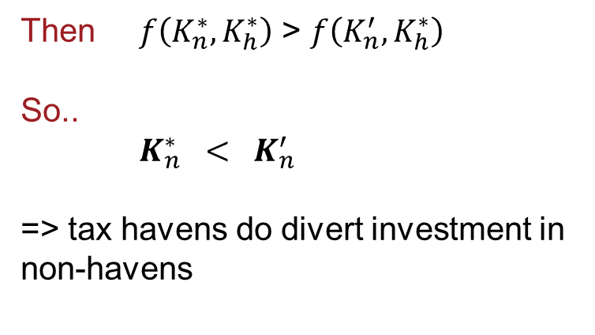
2nd case
$τ_{n}$ = Tax rate on the firm’s foreign investment outside of tax havens
$τ_{t}$ = Tax rate on the profit if the firm also has a tax haven operation
$K_{n}$ = Level of capital investment in non-haven
$K_{h}$ = Level of capital investment in haven
Q($K_{n}$,$K_{h}$) = Production function of firm’s output in countries outside of havens
$\tilde{Q}$($K_{h}^{∗}$)= Return to the tax haven earned in the tax haven itself
$c_{n}$ = Cost per unit of capital investment in foreign countries outside tax havens
$c_{h}$ = Cost per unit capital invested in the tax haven
$K_{n}^{′}$ = Profit- maximising level of foreign investment
$λ$ = Shadow cost
$K_{n}^{∗}$= Fixed amount of capital given in non haven
$K_{h}^{∗}$ = Fixed amount of capital given in tax haven
$f\left(K_{n}^{∗},K_{h}^{∗}\right)$= $f\left(K_{n}^{′}, 0\right)$ (7)
$f\left(K_{n}^{′}, 0\right)$ > $f\left(K_{n}^{′},K_{h}^{∗}\right)$ (9)
Product of capital Investment
Then $f\left(K_{n}^{∗},K_{h}^{∗}\right)$ > $f\left(K_{n}^{′},K_{h}^{∗}\right)$
So..
$K_{n}^{∗} < K_{n}^{′}$
=> tax havens do divert investment in non-havens
$$K_{n}^{∗}$$
$$K_{n}^{′}$$
Capital investment

Slide 14
result
1st CASE: $K_{n}^{′}<K_{n}^{∗}$ => tax havens do not divert investment in non - havens
2nd CASE: $K_{n}^{′}>K_{h}^{∗}$ => tax havens do divert investment in non-havens
We get two different results.
Conclusion? The result is theoretically ambiguous.

Slide 15
result
So, the tax havens do not necessarily harm the economic activity in non-havens.
In the end – it depends on tax rates, amount of capital invested, shadow costs etc.

Slide 16
References
Desai, Mihir A. and Foley, C. Fritz and Hines Jr., James R., Do Tax Havens Divert Economic Activity? (April 2005). Ross School of Business Paper No. 1024.

